Slide 1

KALERWE
S.D.A Hymnal
3 ~ Verses
121.
Nze Omwonoonyi Lukulwe.…
~
Chief of Sinners…

Slide 2
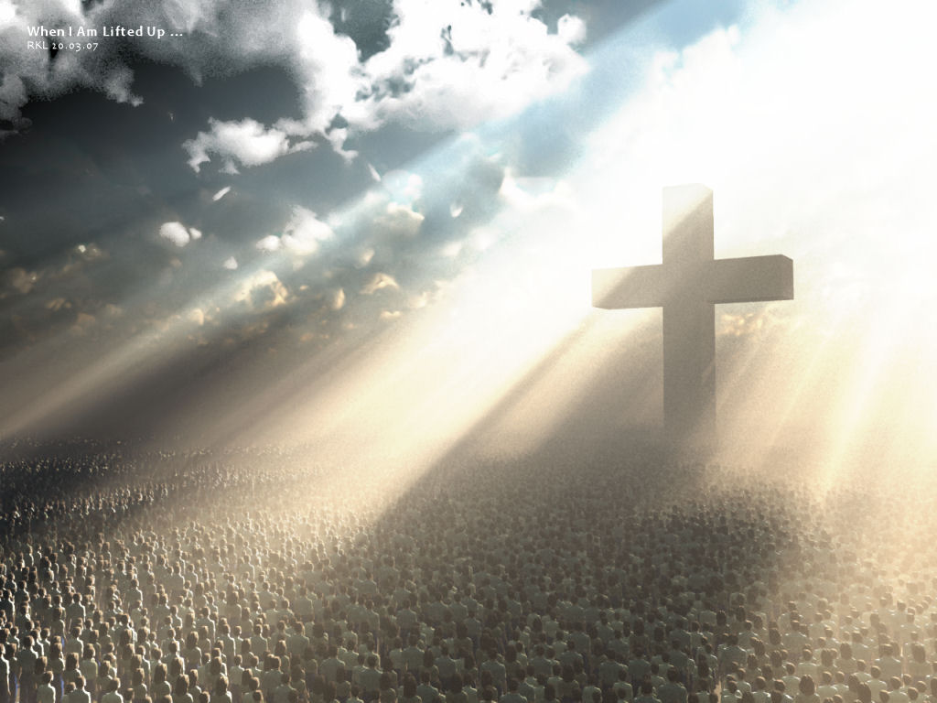
1 of 3 verses
Nz(e) omwonoonyi lukulwe,
Yesu yafa ku lwange
Yafa mbeere mu ggulu,
Yafa nze nneme okufa;
Ng’etabbi ku zzabbibu,
Ndi wuwe naye wange.

Slide 3
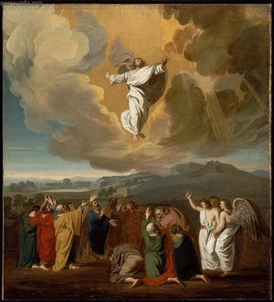
2 of 3 verses
Okwagala kwe kungi
Kutuuka waggulu nnyo;
Era kukka wansi nnyo
Kwo kwa mirembe gyonna;
Yannonya n’anzuula nze
Nga Sinnamukowoola!

Slide 4
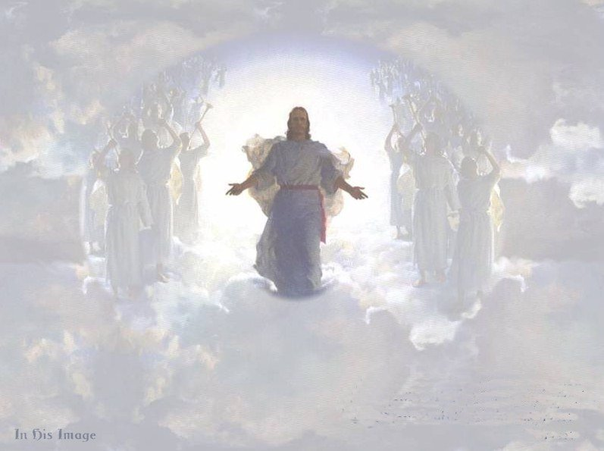
3 of 3 verses
omwonoonyi lukulwe,
Kristo ye byonna gyendi;
Amanyi byeneetaga, annumirwak(o) ennaku;
Nze bwemba naye sitya
Abeera ngabo yange…

